Slide 1

Future Strategy
For Approval by the Board of Trustees

Slide 2

Context
Trustee decision (November 2024) to become a grantmaker with fundraising capability.
Possibility of working in partnership with other organisations to curate holidays (but subject to fundraising and resourcing).
Strong guest support for future plans and involvement in shaping those plans.
Necessity of exiting from Jubilee Lodge without significant financial penalties.
Agreement of a trial period of 1 year in which the charity will attempt to raise funds via Trust and Foundations fundraising to increase the number of guests supported and to seek options for a more generative organisation that works in partnership to deliver holidays.

Slide 3
No change recommended
Our vision (agreed 2021)
A society in which every disabled person and every carer is able to take the break or holiday they want.

Slide 4
No change recommended
Our purpose
To enable disabled people and their families to access and enjoy amazing holidays, breaks and experiences tailored to them, to escape, relax and have fun.

Slide 5
Change
IS recommended
Our values
Inclusive, Change-makers, Caring, Joyful, Hardworking

Slide 6
Current
We are inclusive. We welcome everyone.
We are change-makers. We make things happen for our guests and for disabled people.
We are caring. We care about our guests and about each other. We are guest obsessed.
We are joyful. Fun, warmth and laughter are at the heart of everything we do.
We are hardworking. We strive for excellence and we do not give up.

Slide 7
NEW!
We are inclusive. We welcome everyone.
We are change-makers. We make things happen for disabled people and their families
We are caring. We care about the people we support
We are joyful. Fun, warmth and laughter are at the heart of everything we do.
We are hardworking. We strive for excellence and we do not give up.

Slide 8
No change recommended
Our impact: disabled people and carers experience improved wellbeing and do not reach breaking point

Slide 9


New strapline. Unless we add some kind of strapline or enhancement to our name people will not know what we do, particularly funders.

Slide 10
3 Strategic priorities
Support a growing number of disabled people and carers with holidays, respite and activities
01
Grow the pot of available funding to distribute each year.
02
Collaborate and partner with other organisations to increase impact
03
Notes:
Add recommend

Slide 11
How will we achieve them - guests
Objective | Tactic
To successfully re-launch Revitalise as a grantmaker to previous guests of our centres by March 2026 | Re-launch website with accessible application form and donations function Communications strategy reaching all previous guests on email and social
To generate broad awareness of Revitalise amongst new, cold audiences by end Jan 2028 | Listed on all third-party referral sites Communications plan for social workers Part of information packs from other charities / charity helplines
Deliver a successful first year grants programme to applicants with a 100% award rate, and positive feedback and wellbeing scores, receiving and building on feedback in subsequent years to optimise the experience | Build a seamless end to end user journey and process Ensure accessible application process, adapted for learning disability. Design and deliver a wellbeing impact measurement Continuously learn and improve
Notes:
TACTIC
Website KPIs
- Functionality working as planned, 80% positive user feedback first 3 months
Impact monitoring process delivers continuous learning and optimisation of charitable activities - Process designed and delivered by Feb 2026.
Optimisations based on feedback made and receive good feedback
Relaunch KPIs
28% open rate on guest emails, 80% positive feedback in response to news

Slide 12
How will achieve them - income
Objective | Short term tactic
Grow Trust and Foundation Fundraising income from sub £5k base to £180k per annum, eventually delivering a 6:1 ROI by 2028 | New Trust and Foundations pipeline - Feb 2026 New Case for Support and materials – Feb 2026 Communications plan for legacy pledgers / donors Fundraising resource in place – Feb 2026 All planned applications submitted within timeframes – Jan 2027
Re-ignite legacy income to ‘pre-closure’ average of c. £250k per annum by 2029, maintaining it sustainably | Communications plan for legacy donors written and delivered with long-term plan in place. More active management of legacy pipeline.
Revitalise’s capital to be making avg 8% per annum by 2027 via sensible investment strategy | Source and appoint appropriate financial management advisors and agree investment profile and risk levels with clear policy in place.
To have a clear view of other opportunities for fundraising income growth and a robust business case by January 2026 | Review corporate and Major Donor landscapes and decide whether there are opportunities for Revitalise

Slide 13
How we will achieve them – partnering and collaborating
Objective | Tactic
4 partnerships with relevant holiday providers to the benefit of disabled people by Jan 2027 | Approach new proprietors of Jubilee Lodge and Sandpipers about opportunities to fund guests there. Scope out opportunities with the Clacton bungalow. Speak to Warner Hotels to understand collaboration opportunities. Conversation with The Calvert Trust
2 partnerships with other funders for the joint benefit of disabled people and carers by January 2027 | Conversations with The Respite Association and CS Disabled Holidays about match funding.
2 partnerships with other, complimentary providers for the joint benefit of disabled people and carers by January 2027 | Research and approach transport companies, equipment suppliers, etc.
Notes:
Positive feedback from guests on their experiences – 85%

Slide 14
KPIs
See separate document

Slide 15
The Foundation
How it will work

Slide 16
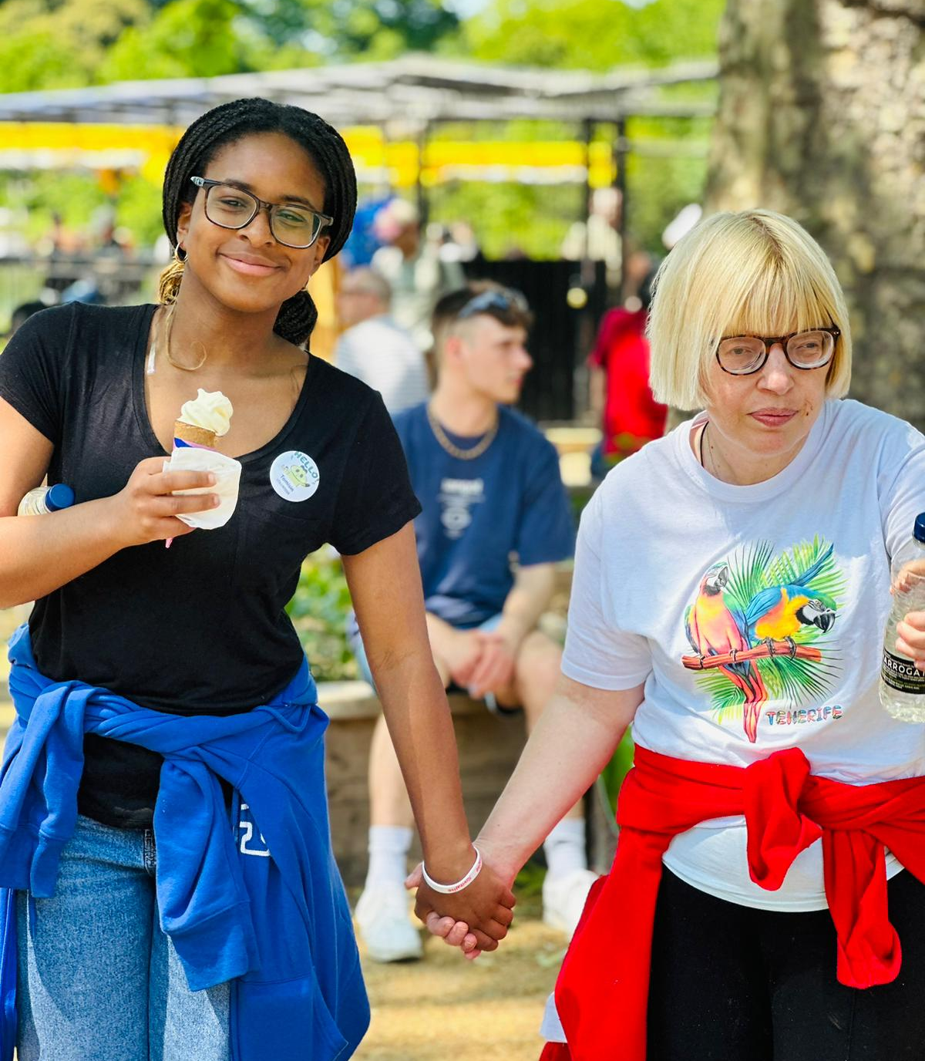
What we fund
True to our heritage
Holidays and respite
Trips and outings
Opportunities for people to connect and socialise.
*Review after 3 years and consider whether to diversify
Notes:
REVIEW AFTER 3 YEARS
Mobility and adaptions.
Transport to access the community.
Adaptions at other holiday locations.
Relief of general financial hardship.

Slide 17
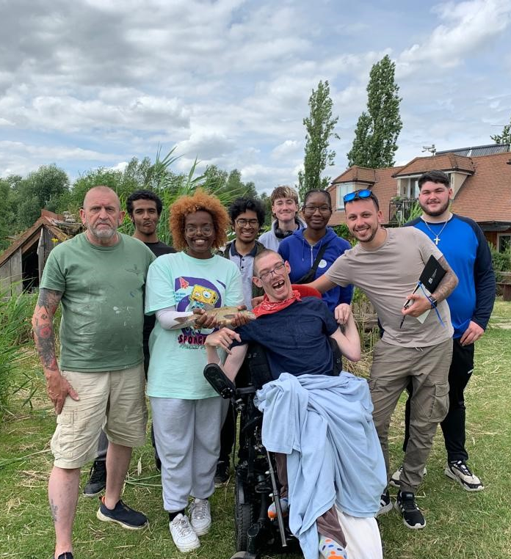
Fostering community and connectivity
Keeping the Revitalise magic alive:
Welcoming group grants for group trips or events
Working with Sandpipers and Jubilee Lodge plus other locations to fund a Revitalise week.
Funding the bi-annual Revitalise reunions

Slide 18

How much we fund
The Board’s decision:
Research overwhelmingly in support of small grants to as many people as possible regardless of means.
£500 per person.
Discreet number of larger grants for individuals in crisis (to be decided)
£100 per person for day activities

Slide 19

The application process
Flexible and accessible:
Quarterly in line with Board meeting schedule.
Applications in between go to 3 Trustees for decision (TBD)
Online and paper with a window each quarter for phone applications.
Resources to support the application process - list of potential providers, a step by step guide to reduce accessibility barriers.

Slide 20

Demonstrating impact and compliance
Supporting fundraising, reporting and evaluation:
For holidays or respite breaks, Revitalise pays the provider directly. After the break, the guest fills in an impact form so we can capture how the break helped them.
If a guest is not satisfied with their trip, this is between them and the provider.
Grants for day trips are given direct to the individual. The individual must still complete an impact form.

Slide 21

Frequency of Grants
Ensuring fairness
Guests can reapply for a grant after 12 months
Prioritise those who have not benefitted from a grant previously.
Second prioritise those who have not applied for a grant the previous year.

Slide 22
Grantmaking Process
Applications Open | Advertise grant round on website, email, local groups and partner channels. Clear guidance on number of grants available, size, eligibility and time frame. Accessible resources readily available.
Applicant Submits Application | Submissions accepted online, via email and paper. To discuss if quarterly phone workshops to be run.
Initial Admin Check | Grant Administrator checks for eligibility, completeness of information, if applicant has received a grant in the timeframe, and eligibility of provider. Queries resolved directly with applicant.
Application Logged | Grant Administrator logs on grant management system.
Trustees Review – Monthly | Monthly approval of applications (TBD) Trustees presented with summaries and recommendations (first-come-first-served basis). Trustees approve applications.
Decision Notification | Grant Administrator sends official outcome notification. Successful applicants receive grant offer letter and terms.
Grant Acceptance | Applicant signs grant agreement.
Grant Payment | Fundraiser contacts provider and arranges transfer once agreement is returned. Payment recorded in accounts and CRM.
Monitoring & Reporting | Grantee submits impact report post-holiday. Fundraiser tracks reports, collects case studies, and flags negative experiences for provider review. Provider list updated if needed.
Evaluation & Learning | Fundraiser analyses data, report provided to trustees, and strategy reviewed. Case studies and outcomes shared externally (website, annual report). Partners and grant foundations informed.

Slide 23
Budget and resourcing
Short and medium term

Slide 24
Structure during trial period
Board of Trustees
Chief Executive
Fundraising and Grant Manager
Outsourced finance, IT, payroll

Slide 25
Comments on structure
This structure is intended initially to see the charity through a ‘concept year’ in which the possibility of being able to fundraise to create a more generative organisation will be tested.
It may not end up being the permanent resourcing model for the charity because:
The level of fundraising resource assumed is too high when benchmarked against the sector ROI range.
It may not be possible to raise the sum of money assumed in the Fundraising strategy.
There may not be other sources of sustainable income the charity can grow.

Slide 26
Budget
See separate document

Slide 27
Key messaging
Describing who we were and who we are

Slide 28
Describing our journey
Our history
Founded as The Winged Fellowship Trust in 1963, we provided unique respite holidays for over 60 years. Since, 1996, when we were renamed Revitalise, we have provided over 42,000 respite breaks to people in real need. However, in November 2024, we were left with no option but to close our holiday centres due to the huge increases in the costs of providing our breaks and the reductions in available respite funding from Local Authorities and grant-makers.
Despite this, we were determined to continue the legacy of our Founder, Joan Brander, in ensuring that disabled people and carers continue to enjoy the breaks and holidays they need. Caring for a loved one can be relentless and exhausting and without respite, many carers reach burnout. For disabled people needing care support, accessing appropriate holidays, social activities and opportunities to make social connections can be extremely challenging, leaving many disabled people experiencing loneliness and social isolation.
Today, our vital work focuses on providing grants to enable disabled adults and their family carers to enjoy the respite breaks, holidays and social connections they need.

Slide 29
And what we do
What we do
We provide funding for respite breaks and holidays, social activities like day trips, and opportunities for people to meet and make social connections. Any disabled person or carer over the age of 18 can apply for a grant towards a break or experience that would make a meaningful difference to them.
How it works
Applications are open year-round and each month we have a maximum amount of grants we can distribute. This is because as a small charity there is a maximum number of grants we can give out each year. We give priority to those who have not had a grant before or in the last 12 months, but welcome repeat applications.
We also welcome applications from groups who wish to holiday or take a trip together.

Slide 30
Fundraising strategy

Slide 31
Background
UK Trust and foundation fundraising will be highly competitive in 2026 due to increased demand for services and the economic pressures of the "big squeeze," which are driving up costs and creating greater competition for limited funding. This perfect storm is made worse by the winding down of one-off COVID-19 funds, higher application numbers, and the lingering effects of austerity and the cost-of-living crisis, causing success rates to fall significantly.

Slide 32
Insights from fundraisers across the sector
Majority of fundraisers have seen a shrinking portfolio of trust and foundation prospects (2024)
Higher competition a major barrier for trusts and foundations grants.
Funders changing their priorities to themes that affect an organisation’s eligibility another challenge.
Funders are also taking longer to confirm grants.
Grant schemes capped at £5k (Revitalise’s heartland) are facing a disproportionately high volume of applications.
Total avg success rate was 35.59% on an avg value of pipelines at just over £1m with a range of £5000 to £7m (2024).
Clear success rate difference between cold and repeat funders (24.5% vs 63.39%). Warm/repeat applications 1.72x greater income vs cold, despite cold representing 68% of pipelines.
Avg success rate dropped to 26 per cent for fundraisers that sent more than 100 applications a year, although for repeat funders this figure was 48 per cent.
Room for cautious optimism with more fundraisers forecasting growth or income to stay the same (2025).
**Insights drawn from largest sector survey of Fundraisers by Gifted Philanthropy for the year 2024 and other sources

Slide 33
Insights from fundraisers across the sector
Most common income ranges raised in 2024 were between £50,000-£200,000 (42%), and £200,000 - £300,000 (30%). 20% of fundraisers raised more than £500,000 - £5m. Only 7.25% raised under £50,000. This provides an interesting benchmark.
Disability had the highest repeat funder success rate of 75%. However, the lowest cold success rate coupled with the highest numbers of applications sent.
Less Trusts are accepting unsolicited applications. Of those successful with an unsolicited approach, 52% did so through connections and networking 19% found funders reached out to them directly which emphasises the need for charities to be visible .
Sending more applications can be a detriment to income. Research shows that the more applications sent, the lower the success rate. This was the same regardless of the application value, total charity size and every other variable measured. There is a clear drop off in success rates and income after 30 applications sent.
**Insights drawn from largest sector survey of Fundraisers by Gifted Philanthropy for the year 2024
Notes:
very high correlation of 0.9 for repeat applications sent vs how many were successful provides high reliability when forecasting income from
warm sources. This was not the case with cold applications, indicating the higher volatility and competition in this approach

Slide 34
Challenges specific to Revitalise
Closure announced to all funders November 2024.
Some were notified of solvency issue during conversations about returning grants.
Last set of accounts shows very significant deficit which will be of concern to some funders
Some funders who donated in 2024/25 will not have had impact reports due to making fundraising team redundant.
No contact for over a year – all funders can therefore be considered ‘lapsed’.

Slide 35
Historic Trust and Foundations Performance
 | 2019 | 2020 | 2021 | 2022 | 2023 | 2024 | 2025 | Total
Grand Total Val | £436,735 | £856,504 | £305,192 | £200,786 | £250,122 | £122,608 | £20,157 | £2,442,105
Grand Total Amount | 161 | 120 | 100 | 91 | 92 | 44 | 16 | 625
Average Grant Size | £2,873 | £7,513 | £3,114 | £2,281 | £2,718 | £2,786 | £1,259 | £10,175
Average Yearly Tot. 2019,21,22,23 | £298,208
2020 is an outlier due to it being a year of emergency COVID grants. (c. £400k)
There has been a decline in total amount received over the years, with 2024 being quite significantly lower. However, the announcement and reduced team from October influenced this heavily.
If you exclude 2020, 2024 and 2025 the average yearly income across this period is £298.2k

Slide 36
Historic legacy performance
Year | Average Leg. Size | Count Leg. | Total Leg.
2019 | £63,739.76 | 19 | £1,211,055.42
2020 | £15,712.90 | 8 | £125,703.16
2021 | £1,647.50 | 11 | £18,122.51
2022 | £25,756.00 | 10 | £257,560.03
2023 | £50,169.95 | 16 | £802,719.18
2024 | £109,680.46 | 11 | £1,206,485.09
2025 | £114,843.05 | 4 | £459,372.17
Overall Avg. Leg | £51,658.45 | 79 | £4,081,017.56
Avg. Count p/ Year |  | 11 | £583,002.51
Legacy income fluctuates considerably year on year but on average we have received £583k in legacy income per annum across the time frame shown.

Slide 37
Implications
Revitalise needs to rebuild trust and confidence with funders via careful communications planning and execution.
Mitigate the competition for grants under £5000 by planning for a much more diverse pipeline of grant sizes.
Prioritise a smaller pipeline of highly relevant funders, giving them more time per application and conducting meaningful relationships.
If the pipeline is large, ensure it has the flexibility to shrink down to an optimal number of applications sent to maximise success rates.
Quality of case for support, evidence and impact is essential.
It’s worth going after unsolicited grants – a good approach, maximizing contacts, and ensuring the charity is visible and can be found by funders is key.

Slide 38
Funding needs
Disabled people and carers across the UK – hardship grants
Core costs – finance, IT, payroll, salaries, office and administration
Project costs – partnerships with third party hotel providers and other innovation projects

Slide 39
Goals
Re-establish and nurture relationships with funders old and new
01
Grow Revitalise’s fundraising year on year to a sustainable threshold
02
Maximise unrestricted donations which can be generally applied
03
Notes:
Add recommend

Slide 40
Objectives
Raise awareness amongst previous funders that Revitalise did not close and has transformed into a grantmaker – by September 2026.
Grow Trust and Foundation Fundraising income from sub £5k base to £180k per annum, eventually delivering a 6:1 ROI by 2028.
Re-ignite legacy income to ‘pre-closure’ average of c. £583k per annum by 2029, maintaining it sustainably.
Achieve an appropriate balance of restricted versus unrestricted funding to enable Revitalise to support core costs and investment opportunities.
Have a clear view of other opportunities for fundraising income growth and a robust business case by January 2026.

Slide 41
Pipeline work – methodology and results
We have removed funders no longer relevant from the existing T&F pipeline.
All previously warm funders and any who have not donated in more than 24 months are considered ‘lapsed’.
Any new funders or those who have not donated before are considered cold.
We have set success rates at 9% for cold and 20% for lapsed. This is in line with 2023 success rates and sits below the sector benchmarks.
No consideration has been given towards new potential funders being sourced via further research – important given the change of the charity’s size and activities.
This analysis work produces a sum for 2026/27 in excess of what has been assumed in the forecast. This is because whether or not Revitalise will be an attractive proposition as a grant maker is not proven.
This is also why we have not considered sector benchmarks as relevant yet even though Revitalise’s previous avg success rate (32%) was in excess of the sector benchmark (26%).
Work on this pipeline is ongoing and will be built into the first reforecast of the year but thus far demonstrates that the £180k 3-year figure is realistic.

Slide 42
3 year forecast - methodology
£50k is a reasonable number to raise in year 1 based on previous performance and the Gifted Philanthropy research. No cost or ROI factored in due to need to upweight resource for the first six months to get fundraising going
We would expect to at least double that in year 2, based on previous performance and the level of resource dedicated to fundraising, which will remain high.
By year 3 our aim is to be at optimum income and ROI level. We have based this both on our historic fundraising efforts and an analysis of The Respite Association’s fundraising, which was £182k for 2024 and has grown consistently over the last few years.
Resourcing is based on Trust and Grants Manager role at £60k per annum including on-costs, spending 50% of their time on Fundraising
The ROI is at the lower end for T&G fundraising but remains respectable.

Slide 43
3-year forecast
 | Year 1 | Year 2 | Year 3
Forecast | £50,000 | £100,000 | £180,000
ROI | N/A | 3:1 | 6:1
Cost | N/A | £30,000 | £30,000

Slide 44
Tactics
Conduct research into new T&F funding opportunities given smaller size of charity.
Refresh Trust and Foundations pipeline, prioritising by relationship and application due date.
Communications plan to all funders in Feb 2026.
Tailored plan for previous very warm and repeat funders.
New and compelling case for support.
Sign up for Smee and Ford’s discretionary legacy service.
Communications plan for all legacy pledgers / legacy database about future of charity.
Tactical plan for cold approaches to invite only Trusts of high relevance.

Slide 45
Governance
Short and medium term

Slide 46
Short term changes
No change to legal structure (see associated paper).
New Articles of Association (to be passed by Special Resolution).
Voting of Neil Crouch onto the Board as Trustee with lived experience.
Decommissioning of the FAR Committee once the Jubilee Lodge disposal is complete.
Convening of panels of Trustees to approve grant applications between quarterly meetings (proposal to split the Board and rotate)
Continued support from RG for first few months as the new charity embeds, followed by responsibilities passing to the CEO.
New impact monitoring framework (requirement under SORP).
Longer term: review role of the Board in light of learnings around fundraising and its implication on the charity’s activities.

Slide 47
Next Steps Launch and first six months
Board sign off on strategy
Launch w/c 16th Feb
Communication plan to keep Board updated

